Slide 1
Mid-Term Presentation
Group 6

Slide 2
Survey the various characteristics of cyber attacks to the London Olympics.
Choose the one you believe is the most important and explain your reasoning.
Q1
Q2
What is the impact of the attack you chose in Q1 to the Tokyo Olympics,
how can we achieve resiliency against that?
Q3
What problems or issues may occur at the Tokyo Olympics
which do not occur at the London Olympics

Slide 3
Survey the various characteristics of cyber attacks to the London Olympics.
Choose the one you believe is the most important and explain your reasoning.
Q1
Q2
What is the impact of the attack you chose in Q1 to the Tokyo Olympics,
how can we achieve resiliency against that?
Q3
What problems or issues may occur at the Tokyo Olympics
which do not occur at the London Olympics

Slide 4
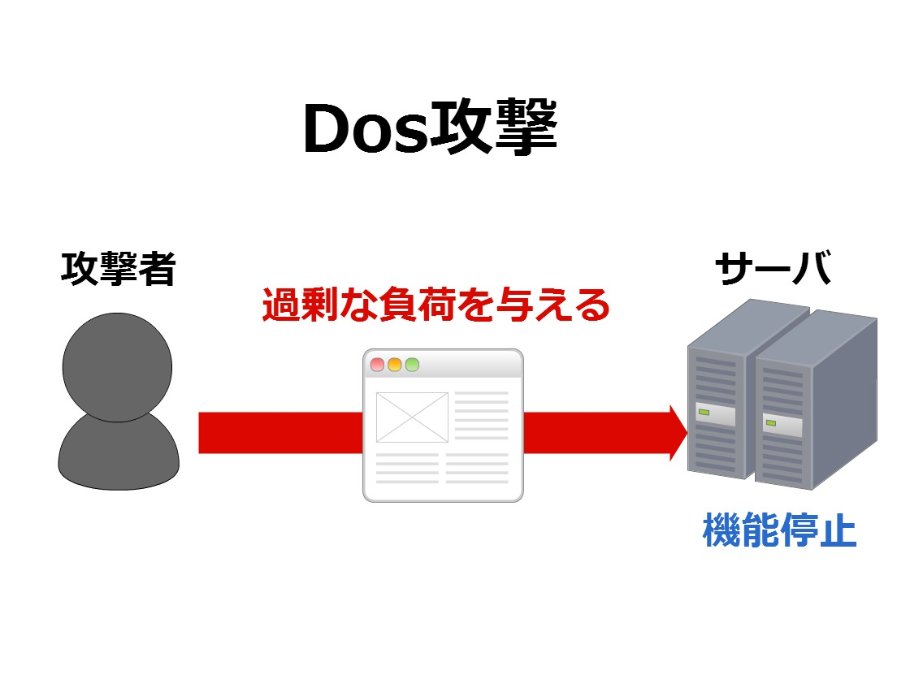
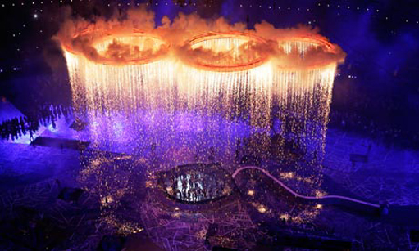
Attack on power infrastructure / opening ceremony
At opening ceremony in London Olympics, power infrastructure was attacked many times. (DoS attack)
"The visual cyber attack"
Because the opening ceremony is a one-time event, people all over
the world will be watching and will be looking forward to the Games,
leaving the ceremony extremely vulnerable to attack.
The opening ceremony is largely symbolic, representing countries
from around the world coming together to compete.
A large-scale cyber attack would hurt the principles
of what the Olympic Games represent, the very idea of peaceful
international cooperation and competition.

Slide 5

Attack on critical infrastructure
Hacktivists, political or social activists who commit cyber attacks, are regarded as a group of people who strive to send a social or political message through cyber attacks. Because hacktivists often form organized groups via social media (either Twitter, Facebook, or the deep web), the Olympic committee responds by looking over SNS trigger words or hashtags before the Olympics to be able to take action before hacktivist groups can mobilize and coordinate any attacks. OCCT (Olympic Cyber Co-operation Team), the special team established in MI5 (Military Intelligence Section 5), prepares multiple scenarios of mock cyber attacks to test the strength of the systems powering the Olympics in several different ways to identify and fix security flaws before they can be exploited by malicious hackers.

Slide 6
Survey the various characteristics of cyber attacks to the London Olympics.
Choose the one you believe is the most important and explain your reasoning.
Q1
Q2
What is the impact of the attack you chose in Q1 to the Tokyo Olympics,
how can we achieve resiliency against that?
Q3
What problems or issues may occur at the Tokyo Olympics
which do not occur at the London Olympics

Slide 7
1.
Political Affiliation / Company Affiliation
2.
Technical Aspect

Slide 8
1.
Political Affiliation / Company Affiliation
2.
Technical Aspect

Slide 9
Analysis of Possible Threats to Olympic Games
Type of Cyber Attack | Content of Cyber Attack
DDoS Attack | 11,000 DDoS attacks through to focused HTTP application floods using simultaneous vector attacks. Usage of overflooding servers with packets of information (ping flooding).
Phishing scams | Set up fake copies of official Olympic sites to be used for scamming/illegitimate purposes
Virus and worm programs | Virus and worm programs to release “low orbit ion cannon”-style DDoS attacks or phish for information. Also to create botnet network for other types of cyber attacks.
Attacks on Olympic lighting system | Manually override system to be able to switch off or disable the electrical power grid during the Olympics, causing mass panic and chaos

Slide 10












Slide 11

Sponsors include Critical Infrastructure Key Resources (CIKR) or Information Sharing Analysis Center (ISAC) members. The actions or credibility of the sponsors may become targets for cyber criminals or hacktivists.
The purpose of this bulletin is to provide a strategic outlook for the 2012 Summer Olympic Games and similar events to assist partners in detecting and mitigating related attacks.

Slide 12
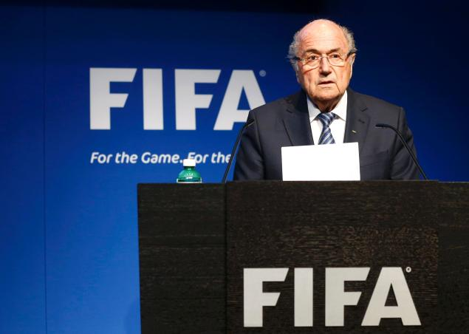

EXAMPLE
FIFA Corruption Scandal
Same sponsors in Olympics
Incentive for Cyber Attacks

Slide 13
1.
Political Affiliation / Company Affiliation
2.
Technical Aspect

Slide 14
Important considerations regarding DDoS attacks
Multiple groups could be responsible
Nation-states / state-sponsored organizations
Private groups (hacker collectives e.g. Anonymous)
Individual hackers
Different groups have different motivations, but most are trying to bring down a network/service
Attack could come at different network layers or attack different targets
Layer 3 or layer 7 network attack
Could target network infrastructure (routers, DNS servers, web servers, database resources)
Could target non-Internet infrastructure (power grid, security systems,
Uptime/availability is priority
During Olympics, any service unavailability would be disastrous
Can’t block legitimate users
Security mechanisms cannot excessively interfere with normal network operation
Notes:
(Korry Luke - koluke@keio.jp)

Slide 15
DDoS Mitigation
Easiest solution: simple firewall/hardware appliance, not extremely effective
most effective solution: traffic filtering/analysis, able to stop sophisticated attacks
Most DDoS-attack prevention companies work by scrubbing and sanitizing data as it passes from the public internet through their network to the designated recipient. By analyzing traffic and looking for patterns in network activity, it is possible to establish a baseline of what “normal” activity is. The most effective solutions involve behavior analysis that “teaches” the system after each attack, not a simple pattern-matching rule set. These “next-gen” systems are generally more effective because they continuously evolve and learn from attacks, and they are capable of detecting attacks that look like legitimate user traffic. An added benefit of adding DDoS-protection equipment is that the site will be more reliable and able to handle more users because fewer malicious requests will reach the target web server.

Slide 16
Past Large-scale DDoS attacks and styles
2014 GitHub attack (believed to be sponsored by Chinese government)
2012 London Olympic power grid attack
2013 attack on Spamhaus
2012 attack on WikiLeaks
Attack styles and vectors
DNS amplification, NTP amplification, mobile ad networks, traffic redirection, botnet using infected computers

Slide 17
Survey the various characteristics of cyber attacks to the London Olympics.
Choose the one you believe is the most important and explain your reasoning.
Q1
Q2
What is the impact of the attack you chose in Q1 to the Tokyo Olympics,
how can we achieve resiliency against that?
Q3
What problems or issues may occur at the Tokyo Olympics
which do not occur at the London Olympics

Slide 18
This, we leave blank for NAIST, if your wondering

Slide 19
Citation & Sources
http://www.bbc.com/news/uk-23195283

